Slide 1
The review of week 3
國立政治大學 資訊管理學系
蔡瑞煌 特聘教授

Slide 2
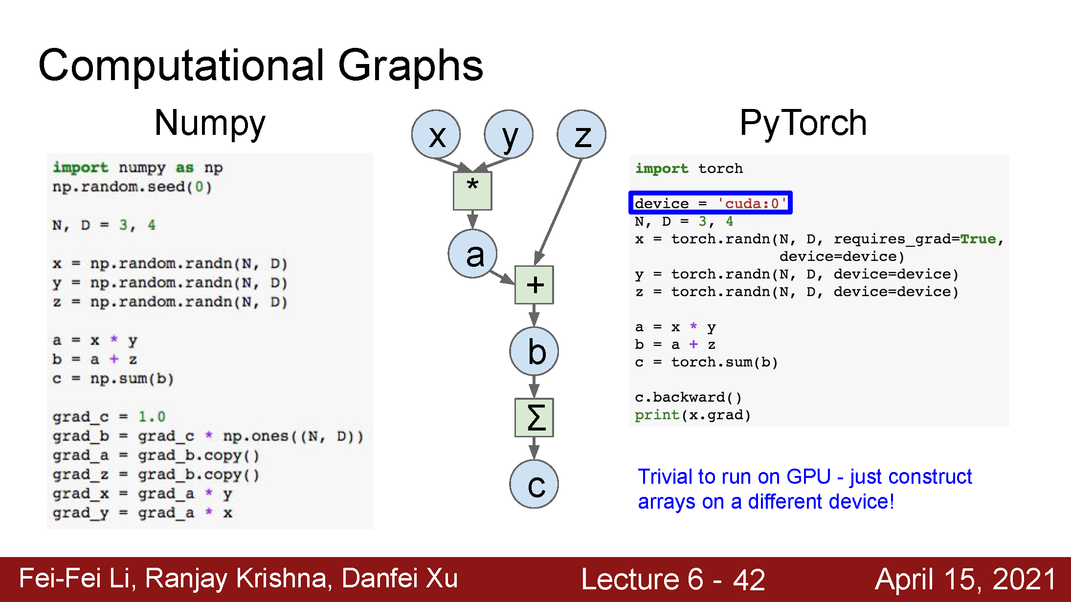
Where we are now...

Slide 3
The process of developing an AI model for the AI-enabled application
Where we are now...
Step 1: Define data attributes and labeling; then collect data
Step 2: Pick up an AI model
Step 3: Pick up a learning algorithm & its code
Step 4: Make the learning with properly tuning the associated hyperparameters (including data preprocessing, initial weights, …) till the model performance is acceptable. If the model performance is still unacceptable, go back to Step 3, or Step 2, or Step 1.
Step 5: Deploy the AI model for inferencing
Training phase
Inferencing phase
3

Slide 4
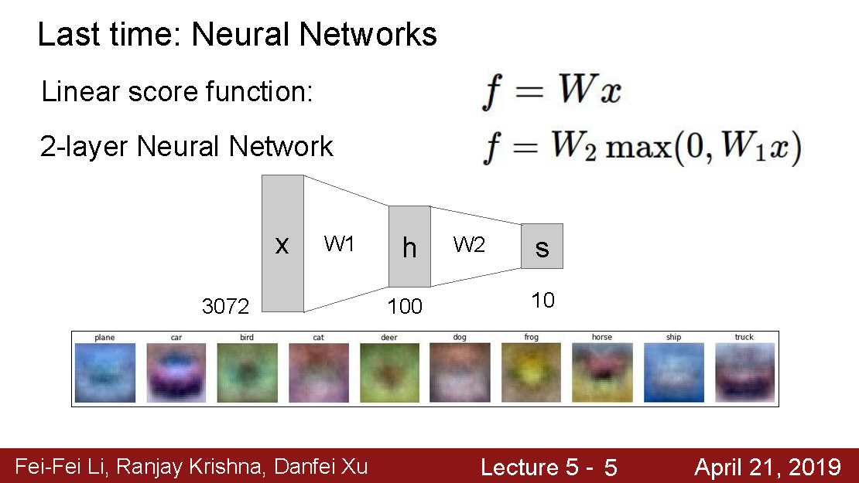
2-Layer Nets; Single-hidden Layer Feed-forward Neural Networks (SLFN)
Where we are now...
hyperparameter: max or tanh or …
hyperparameter: 100 or 150 or 200, …

Slide 5
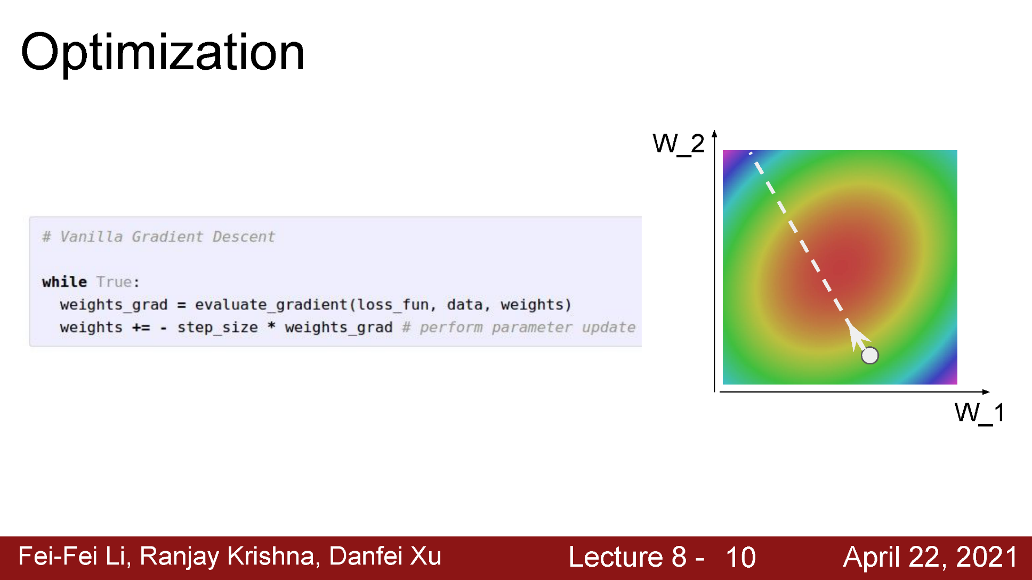

Gradient descent method
Where we are now...
Training phase
$hyperparameter: weights_grad$ = ?
$hyperparameter:step_size$ (i.e., learning rate) = ?

Slide 6
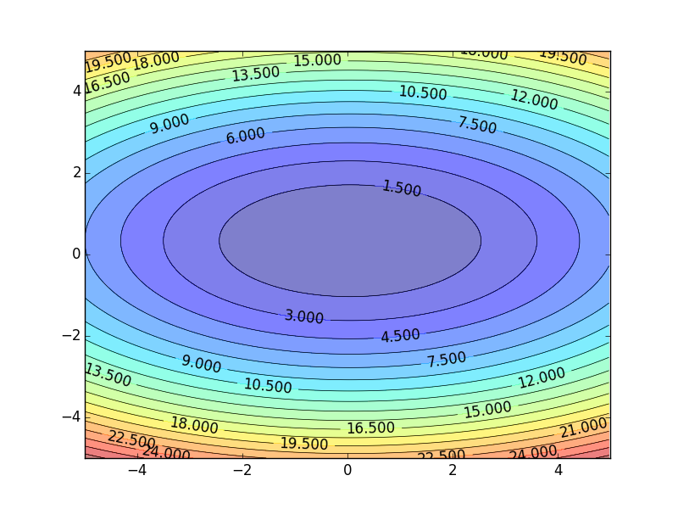




Learning Rate
If the learning rate is too large
-η∇L(w⁰)
The loss function value may not decrease after each update
-∇L(w⁰)
w⁰
Notes:
Just a function

Slide 7
Learning Rate
Learning Rate
Set the learning rate η carefully
If the learning rate is too large
The loss function value may not decrease after each update
If the learning rate is too small
-∇L(w⁰)
-η∇L(w⁰)
w⁰
Training process would be too slow
Notes:
Just a function

Slide 8

The loss function and the learning goal
Where we are now...
Training phase
In the learning stage, a set of N training cases {$\text{(}x^{1}\text{, }y^{1}\text{)}$,$\text{(}x^{2}\text{, }y^{2}\text{)},$ . . . ,$\text{(}x^{N}\text{, }y^{N}\text{)}$} is given.
$\text{Example}\text{: }\text{the} \text{loss} \text{function} \text{of} \text{Mean} \text{Square} \text{Error} \text{is} \text{defined} \text{as}$
$$L_{N}\left(w\right)≡ \frac{1}{N}\sum_{c=1}^{N}{{\left(f\left(x^{c},w\right){−y}^{c}\right)}^{2}}$$
The learning becomes an optimization problem: $\min_{w}{L_{N}(w) }$
Regarding all training cases, the learning goal is to seek a $w$ where, for $all c (training cases)$ and a tiny $$, $\left|f\left(x^{c},w\right){−y}^{c}\right|<ε.$

Slide 9
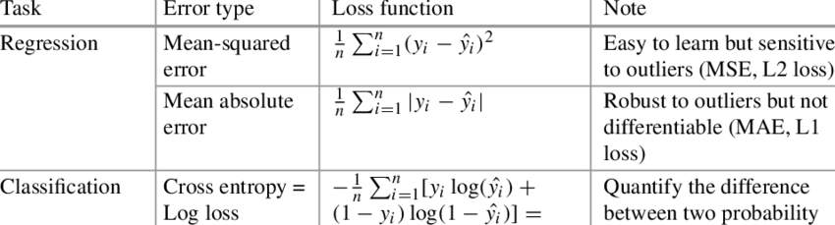
Examples of commonly used loss functions in machine learning

Slide 10
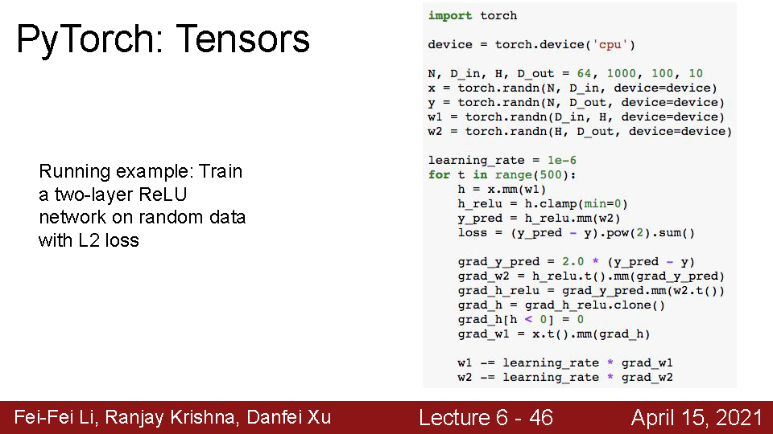
The Code for SLFN and its learning
Training phase
Underline indicates hyperparameter
Create the data (x, y) and weights
Loop
The forward (model) + loss operations
The backward (gradient) operation
The weight adjustment (gradient step) operation

Slide 11
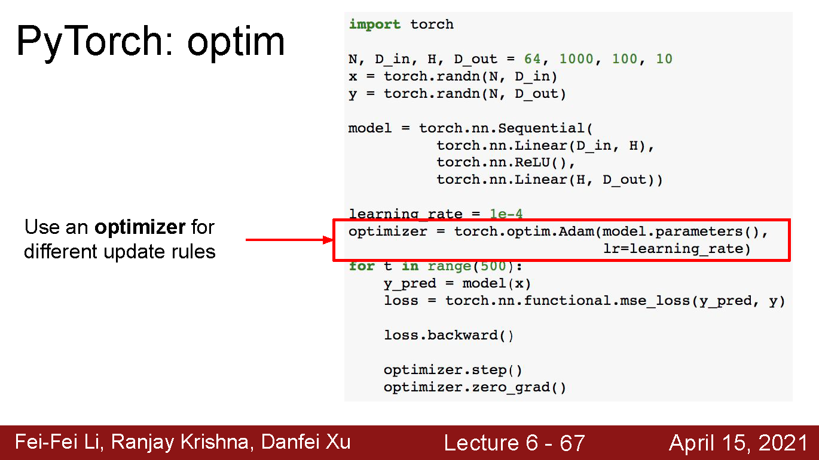
The code structure with updated version of AI framework
Training phase
Underline indicates hyperparameter
Create the data (x, y) and weights
Define the model
Define the optimizer
Loop
Forward pass: feed data to model, and compute loss
Backward pass: compute gradient with respect to all model weights
Make gradient step on each model parameter (with gradients disabled)
Only change this if you want to try another model

Slide 12
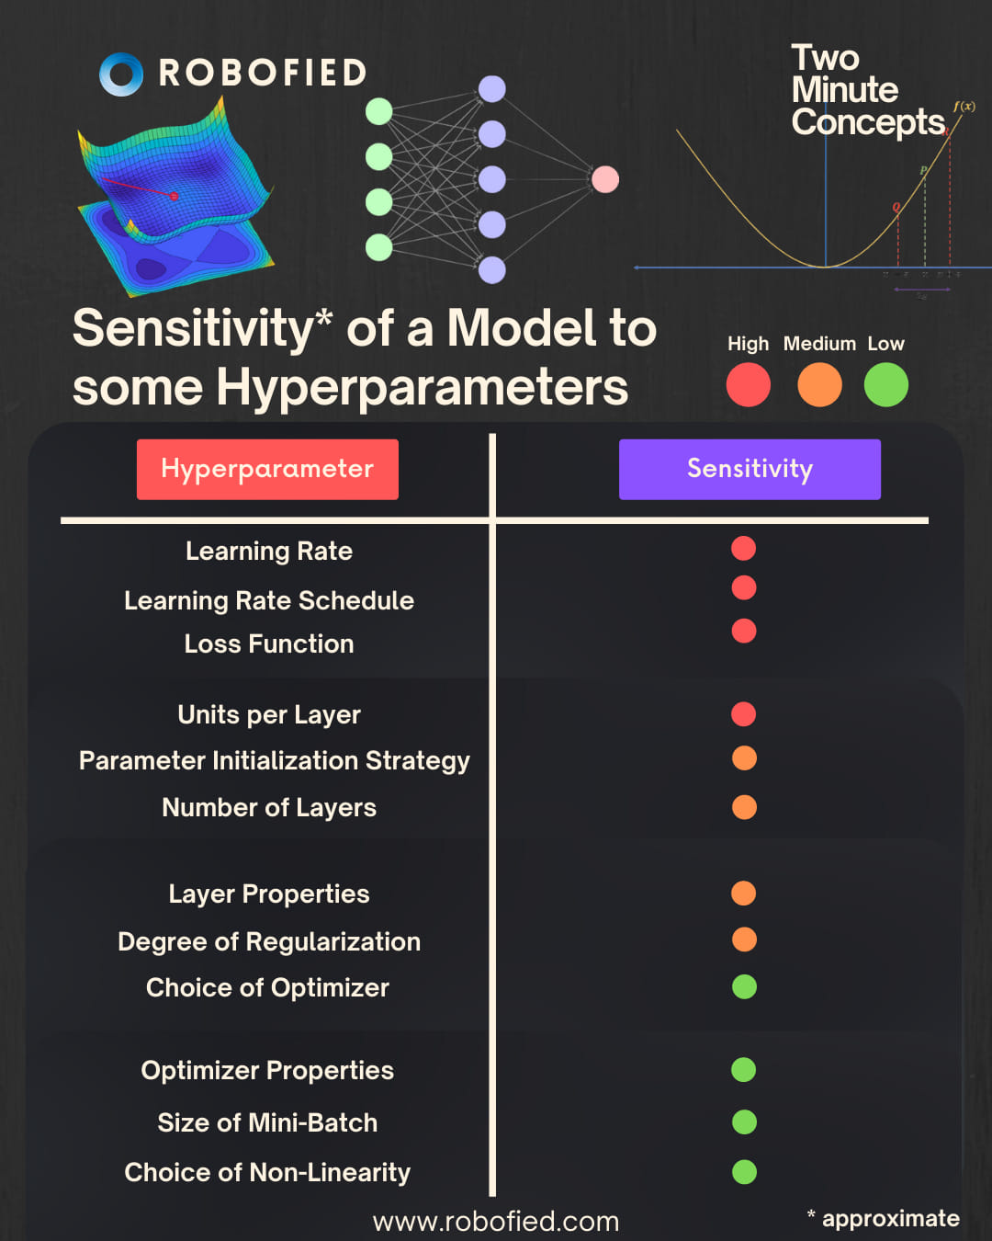
Sensitivity of a Model to some hyperparameters

Slide 13

Homework #1
Due date of homework #1: 3/16 (Thursday)
Implement the code for the 2-layer neural networks in CS231n 2021 version with PyTorch (or TensorFlow).
Once you have the code (regardless of which framework you choose above), you will apply your own data. The training and test dataset is 80%:20%.
You need to run the code with the following hyperparameter settings:
Data preprocessing: none, normalization;
Amount of hidden nodes: 5, 8, 11;
Initial weights: small random number, Xavier or Kaiming/MSRA Initialization
Activation function: tanh, ReLU;
Loss function: without or with the regularization term (L2), $λ$ = 0.001 or 0.0001
$E\left(w\right)$≡$\frac{1}{N}\sum_{c=1}^{N}{{\left(f\left(x^{c},w\right){−y}^{c}\right)}^{2}}$+$λ$($\sum_{i=0}^{p}{\text{(}w_{i}^{o}\text{)}\text{2}}$ + $\sum_{i=1}^{p}{\sum_{j=0}^{m}{{(w}_{ij}^{H}}\text{)}\text{2}}$)
Optimizer: gradient descent, Momentum, Adam;
Learning epochs: 100, 200, 300;
Learning rate decay schedule: none and cosine
Ensembles: top 3 models
Inferencing phase

Slide 14
The suggested code structure for the homework #1
Data preprocessing;
Amount of hidden nodes;
Initial weights
Create the data (x, y) and weights
Define the model
Define the optimizer
Loop
Forward pass: feed data to model, and compute loss
Backward pass: compute gradient with respect to all model weights
Make gradient step on each model weight (with gradients disabled)
Activation function
Optimizer
Learning rate
Learning epoch
Learning rate decay schedule

